Slide 2
Self improving school systems
Why is it so important?
How far have we come?

Slide 3
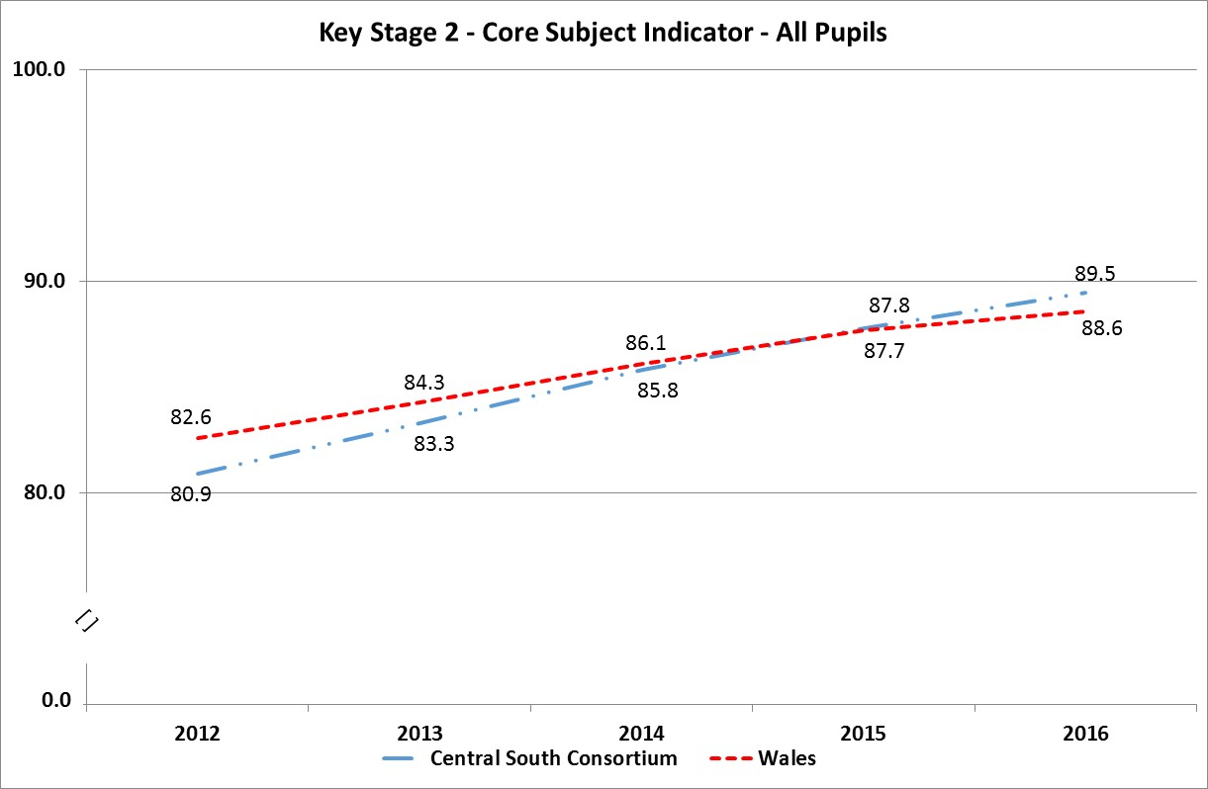
Improving standards at primary level

Slide 4
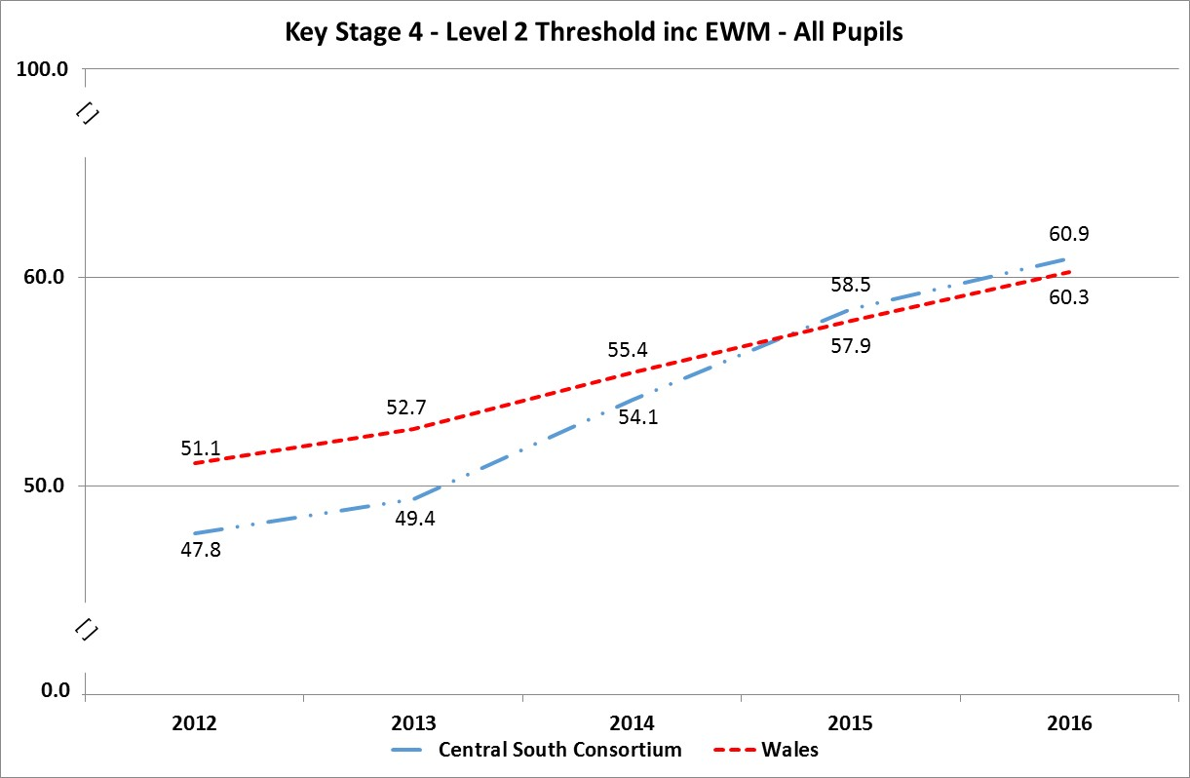
And at secondary level

Slide 5
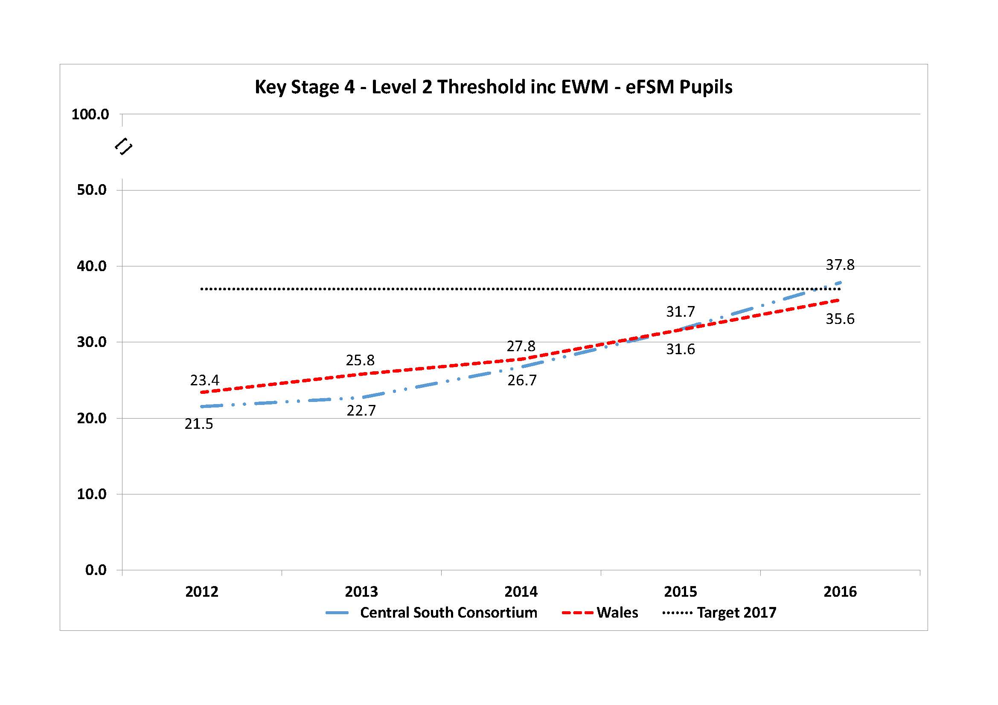
Vulnerable pupils improving fastest

Slide 6
‘Improving schools in Wales: An OECD perspective’ 2014
Welsh Government should...
Attract and develop high-quality human capital
Ensure quality continuous professional development
Streamline and resource school-to-school collaboration.
Treat developing system leadership as a prime driver of education reform.
‘Invest in developing leadership capital across the education system, so that school improvement can be led from within Wales by schools’

Slide 7
‘approaches should focus less on central direction and more on the need to develop local responsibility and decision making, build capacity and engage teachers and schools ...’

Slide 8
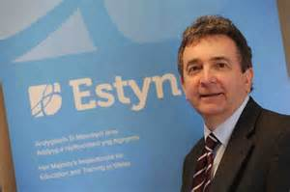
Estyn Annual Report 2017
“The biggest influence on learner outcomes is the quality of teaching and learning.
Various strategies have been introduced in Wales with the intention of improving the quality of teaching and learning, and of helping practitioners to develop their practice throughout their careers.
The aim is to build capacity and to drive out variations within and between schools.
Current education reforms are based on a model of a self-improving system and of school-to-school working.
This means that schools and providers, leaders and practitioners, including teachers and support staff, take responsibility for their own development and that of their peers.
This self-improvement approach is school-led, and balanced by support from local authorities, regional consortia and the Welsh Government.”

Slide 9
Estyn Annual Report 2017
“In the very best schools, there is a strong focus on professional learning for all staff. Teachers and leaders across the schools are involved in an extensive range of networks of professional practice within the school and at local, regional and national level.”
But they also said...
“There is an emerging culture of collaboration and support around professional learning. The challenge for our most successful schools is to ensure that their succession planning processes are robust enough to develop their leadership capacity, so that senior leaders can contribute to school to-school support while not compromising their own provision and development.”

Slide 10
Successful schools are where...
Teachers talk about teaching.
Teachers observe each other teach.
Teachers plan, organise, monitor and evaluate their teaching together.
Teachers teach each other.

Slide 11
The people who work in schools are the best people to lead school improvement...
Creating ways schools can share practice
Teachers discussing / ‘enquiring into’ teaching for improvement
Learning through doing – innovation in practice, risk taking
Work with different schools – moving across schools
Identifying future leaders through leadership across schools
Consortia funds and evaluates different models to share practice
The role of the authority to step in only where necessary
Everyone working together to improve outcomes of all schools

Slide 12
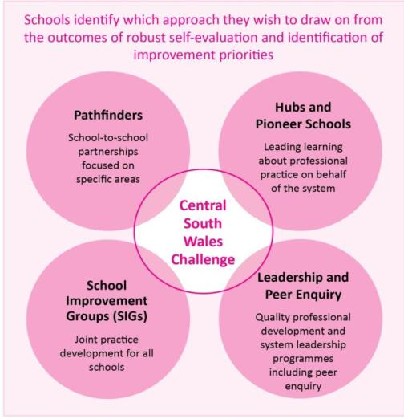
There’s not a one size model: our school-led school to school strategies are designed and developed in the region

Slide 13
Risks and Opportunities
£££
Leadership academy
Successful Futures
Categorisation review
?
Notes:
School to school working is difficult, takes time
May lead to nonproductive time in the early days
May involve only those who can demonstrate improvement
and exclude those who need it most
Not cosy but with discipline and impact
Risk! of revert to original model - top down, measurables, risk averse opportunities
Curriculum reform and performance measures change - an opportunity to develop practice
Leadership academy – time to say what you want and what’s needed
Categorisation – likewise, say what you think and what you want

Slide 14
What are YOU doing?
Identifying practice to share and develop in YOUR school
What does SF mean for teaching and learning in YOUR school?
Identifying future leaders within YOUR school and providing opportunities to them to lead
YOUR school leading school to school working across more than one school which can bring improvement
Developing YOURSELF through sharing with others, inviting colleagues to your school, investing in your learning

